Slide 1

We F-OR You
Team: Bit Byte & Binary
When you can’t do it alone!

Slide 2

Problem Statement
Facilitate NGOs, Environmentalists and Common PEOPLE raise money for their need

Slide 3

Solution
A systematic fundraising enterprise that interacts with digital marketing, payer and payee enterprises and helps the payee financially

Slide 4

Approach
Create Work Request when payee submits an application
Update the work request after each role performs an action onto it
When work request reaches the organizer role, distribute it among the number of volunteers equally (sub work requests)
All the stages of work request are transparent to payee and fund raiser enterprise and hence user friendly

Slide 5



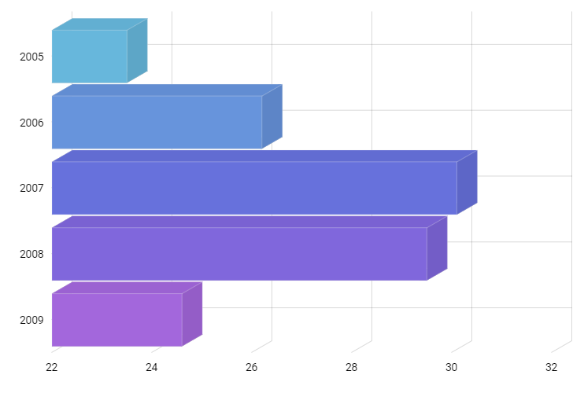

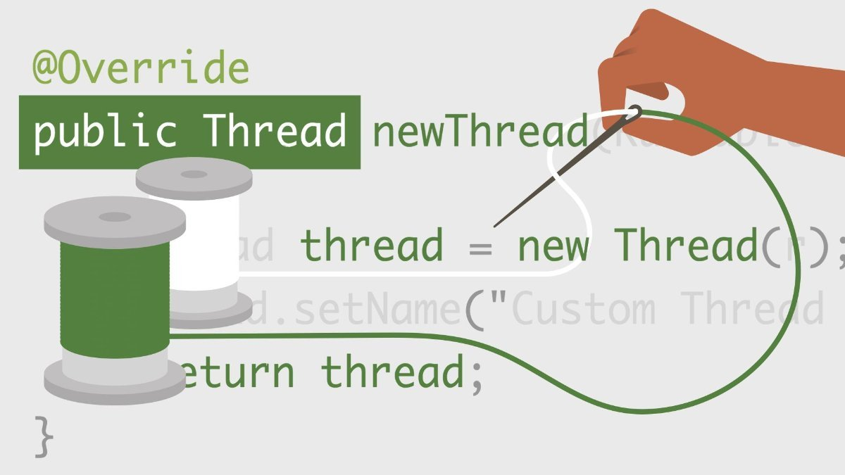
Features

Slide 6

Use Case
Payee (NGO, Environmentalist, Common man): submits an application
Fund Raiser Executive: forward to request to BCE
Background check Executive: approve/reject
Social Media Expert: advertise
Organizer: Create tasks and upload on dashboard, monitor volunteer’s performance
Volunteer: Picks an available task
Payer: Contribute using volunteer’s recommendation

Slide 7

Design

Slide 8
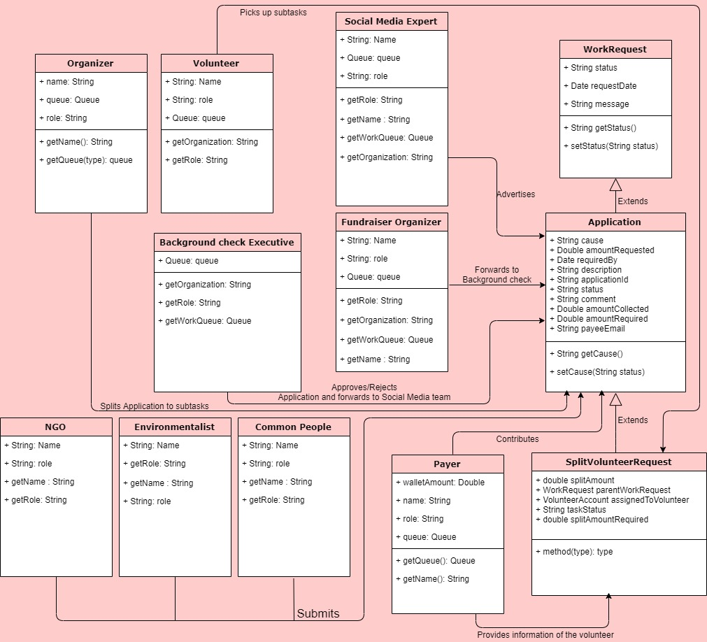

Slide 9

Workflow
Payee
Fund raiser Executive
Background check executive
Social Media Expert
Organizer
Volunteer
Payer

Slide 10

Screenshots

Slide 11
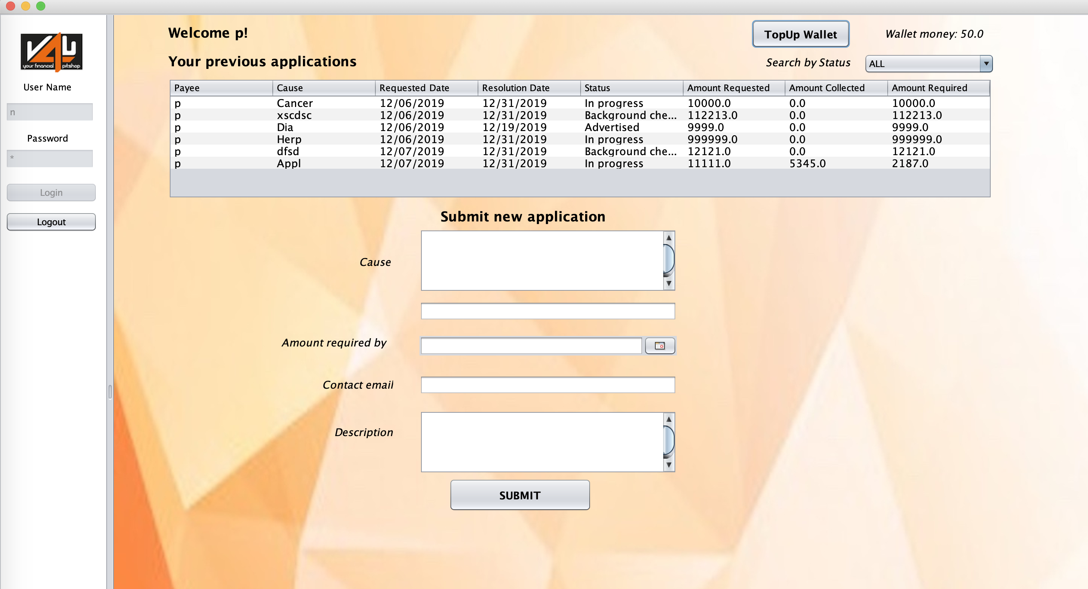

Slide 12
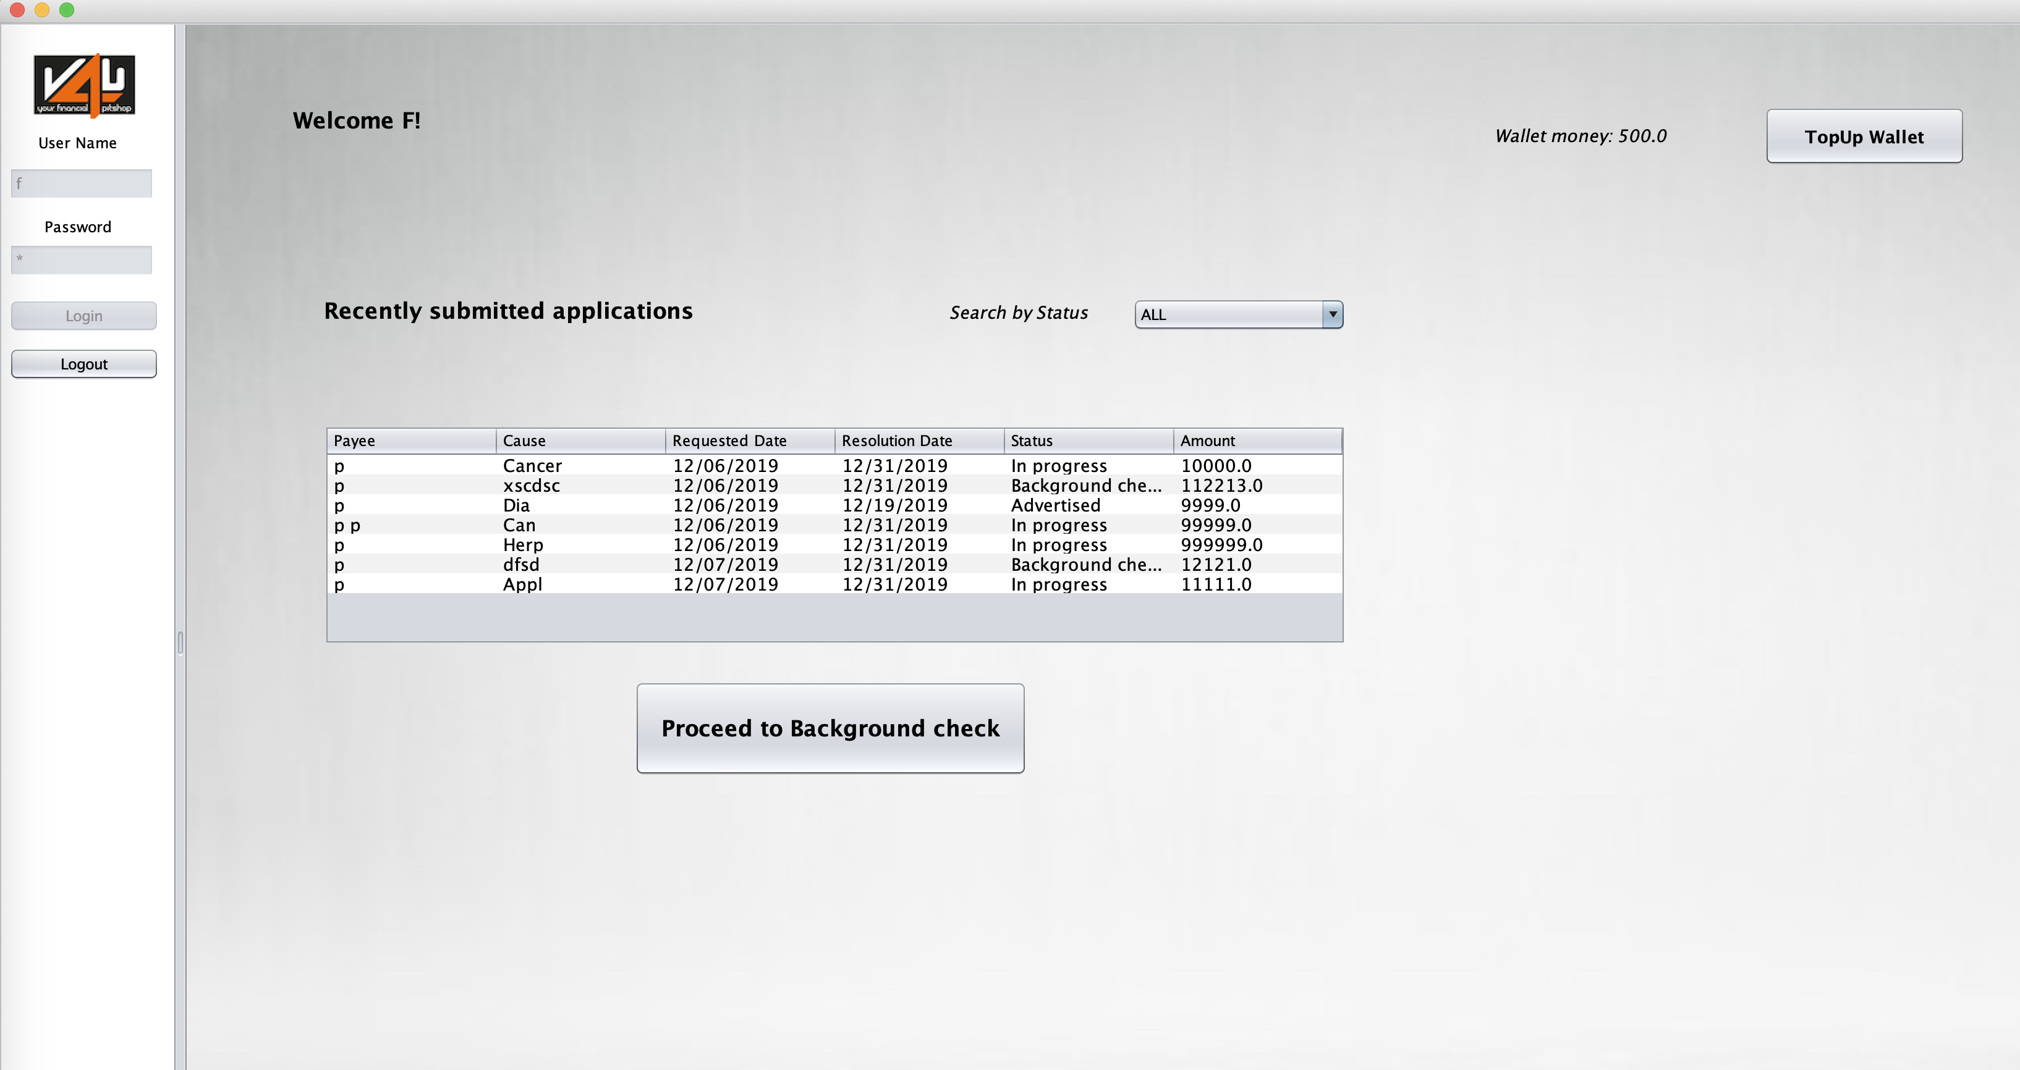

Slide 13
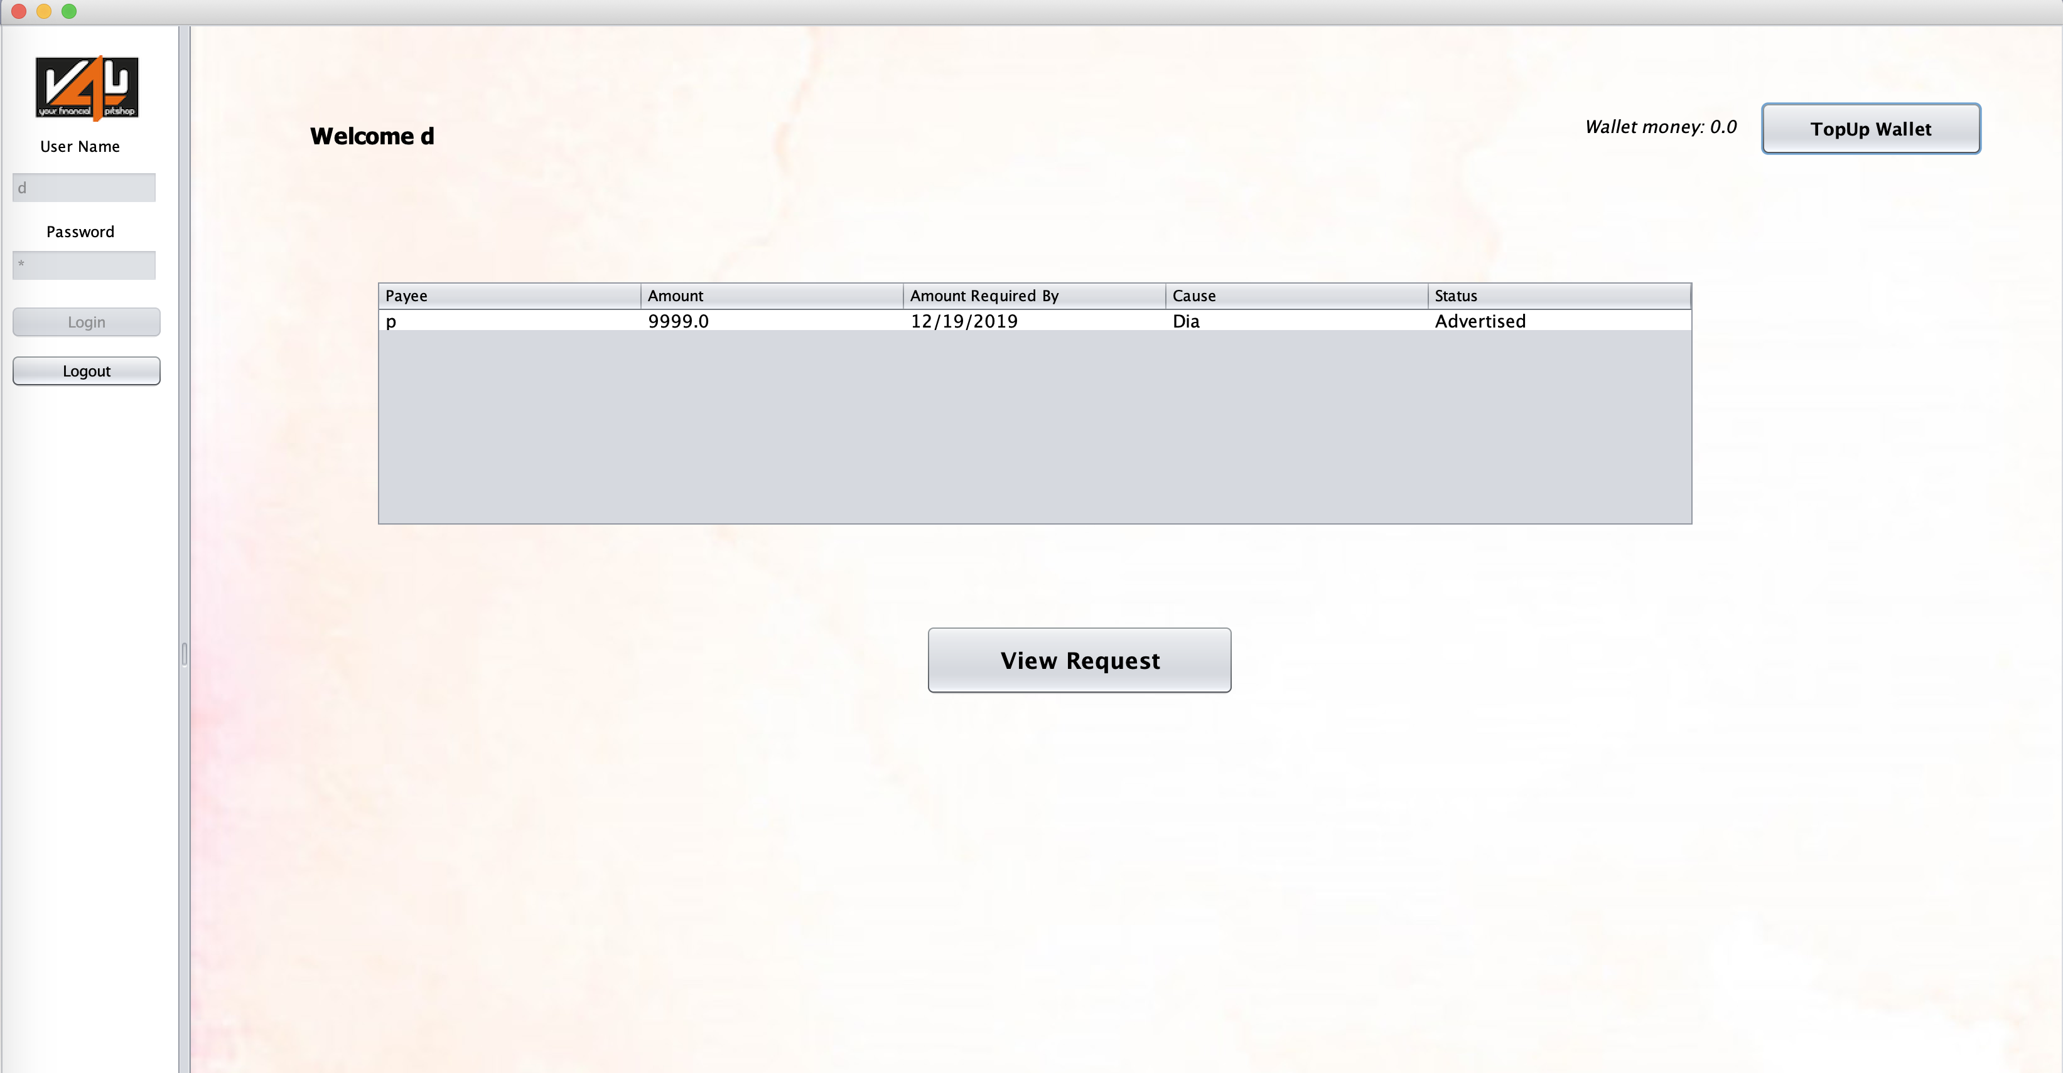

Slide 14
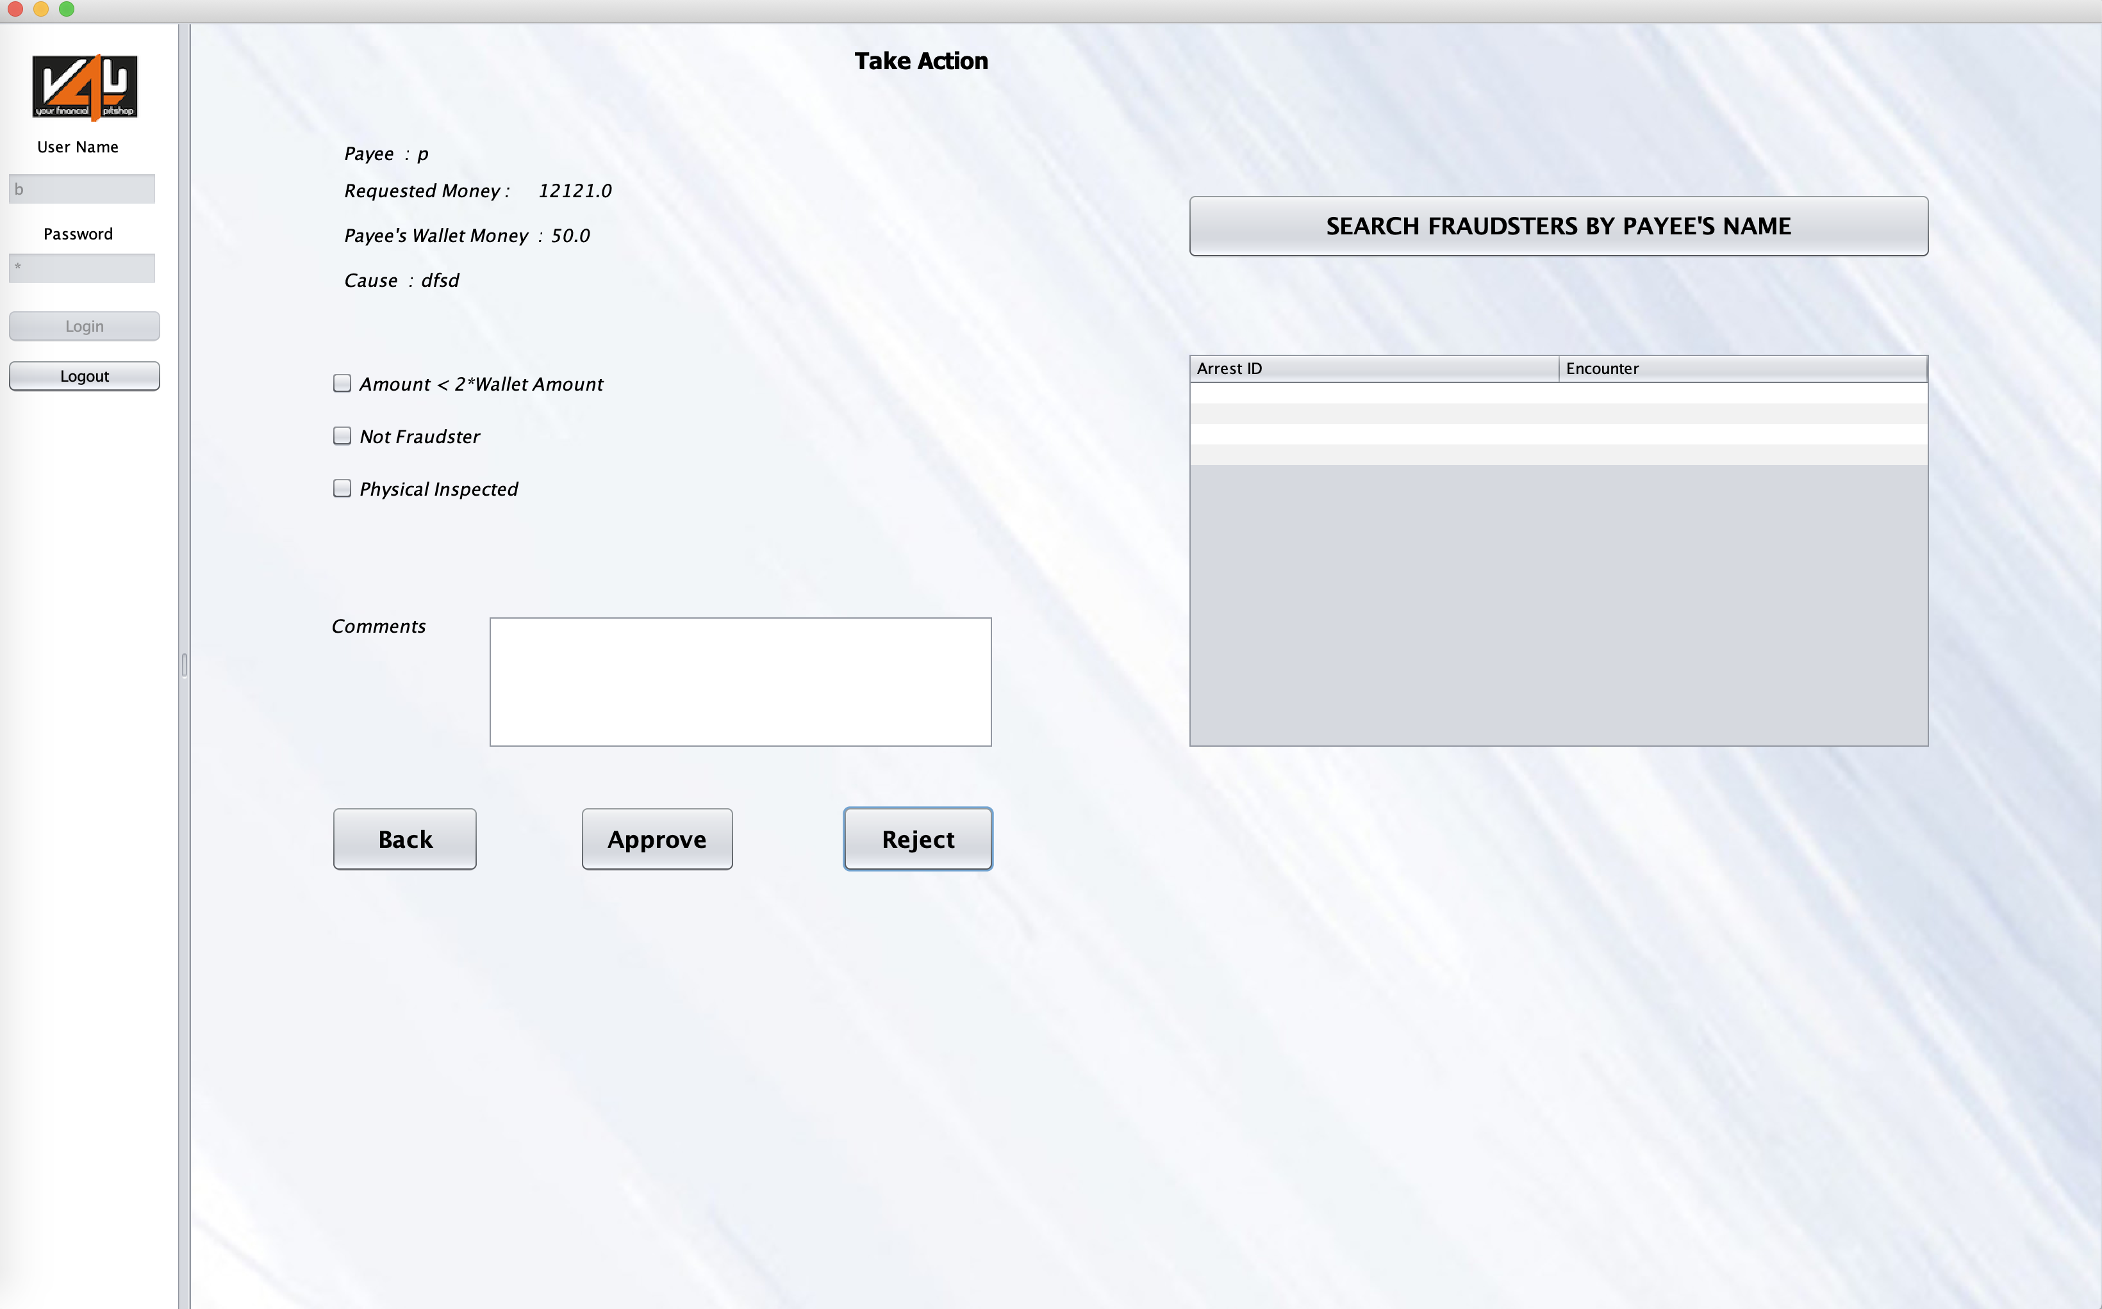

Slide 15
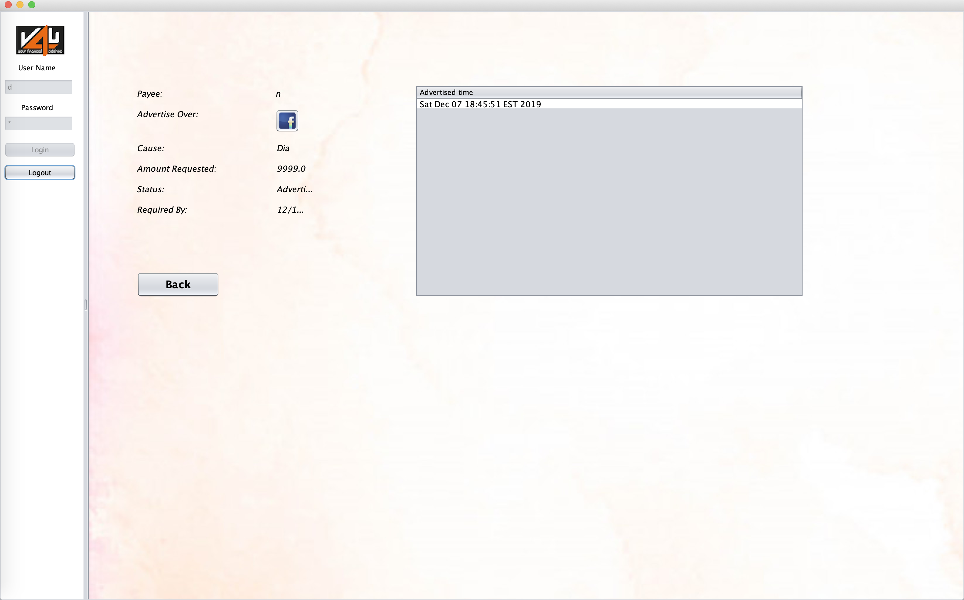

Slide 16
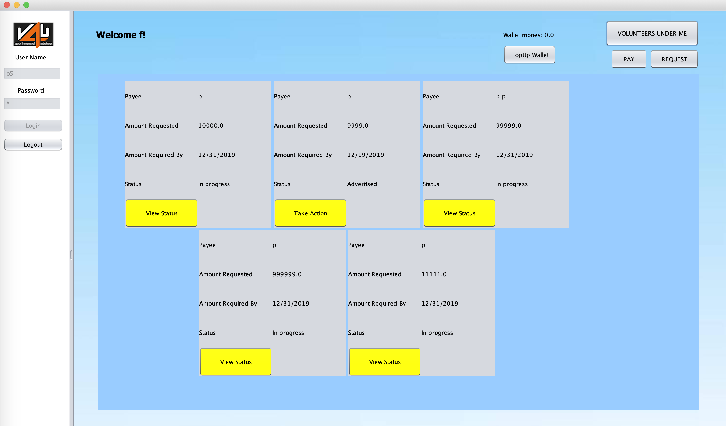

Slide 17
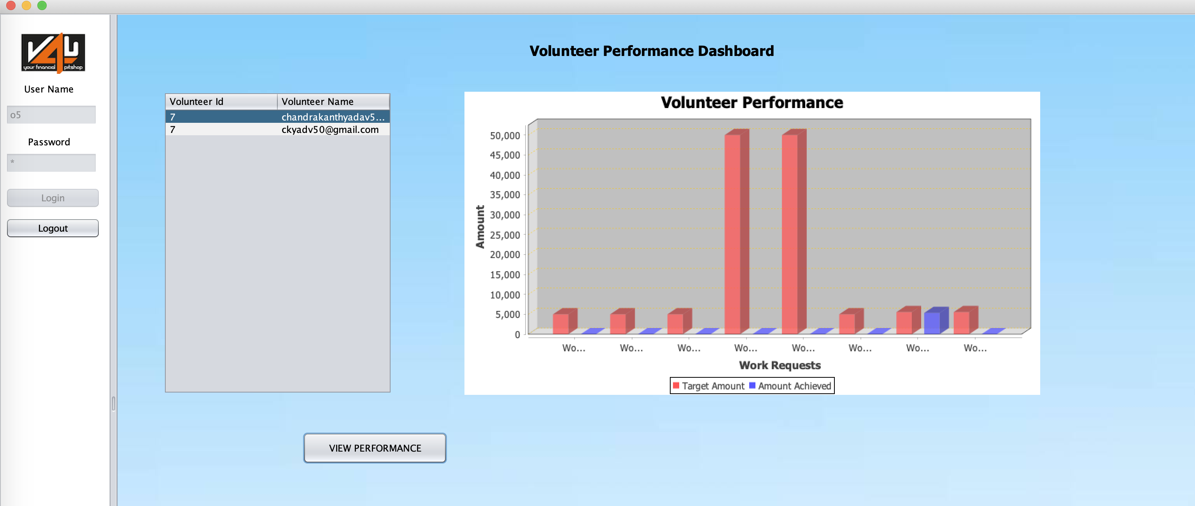

Slide 18
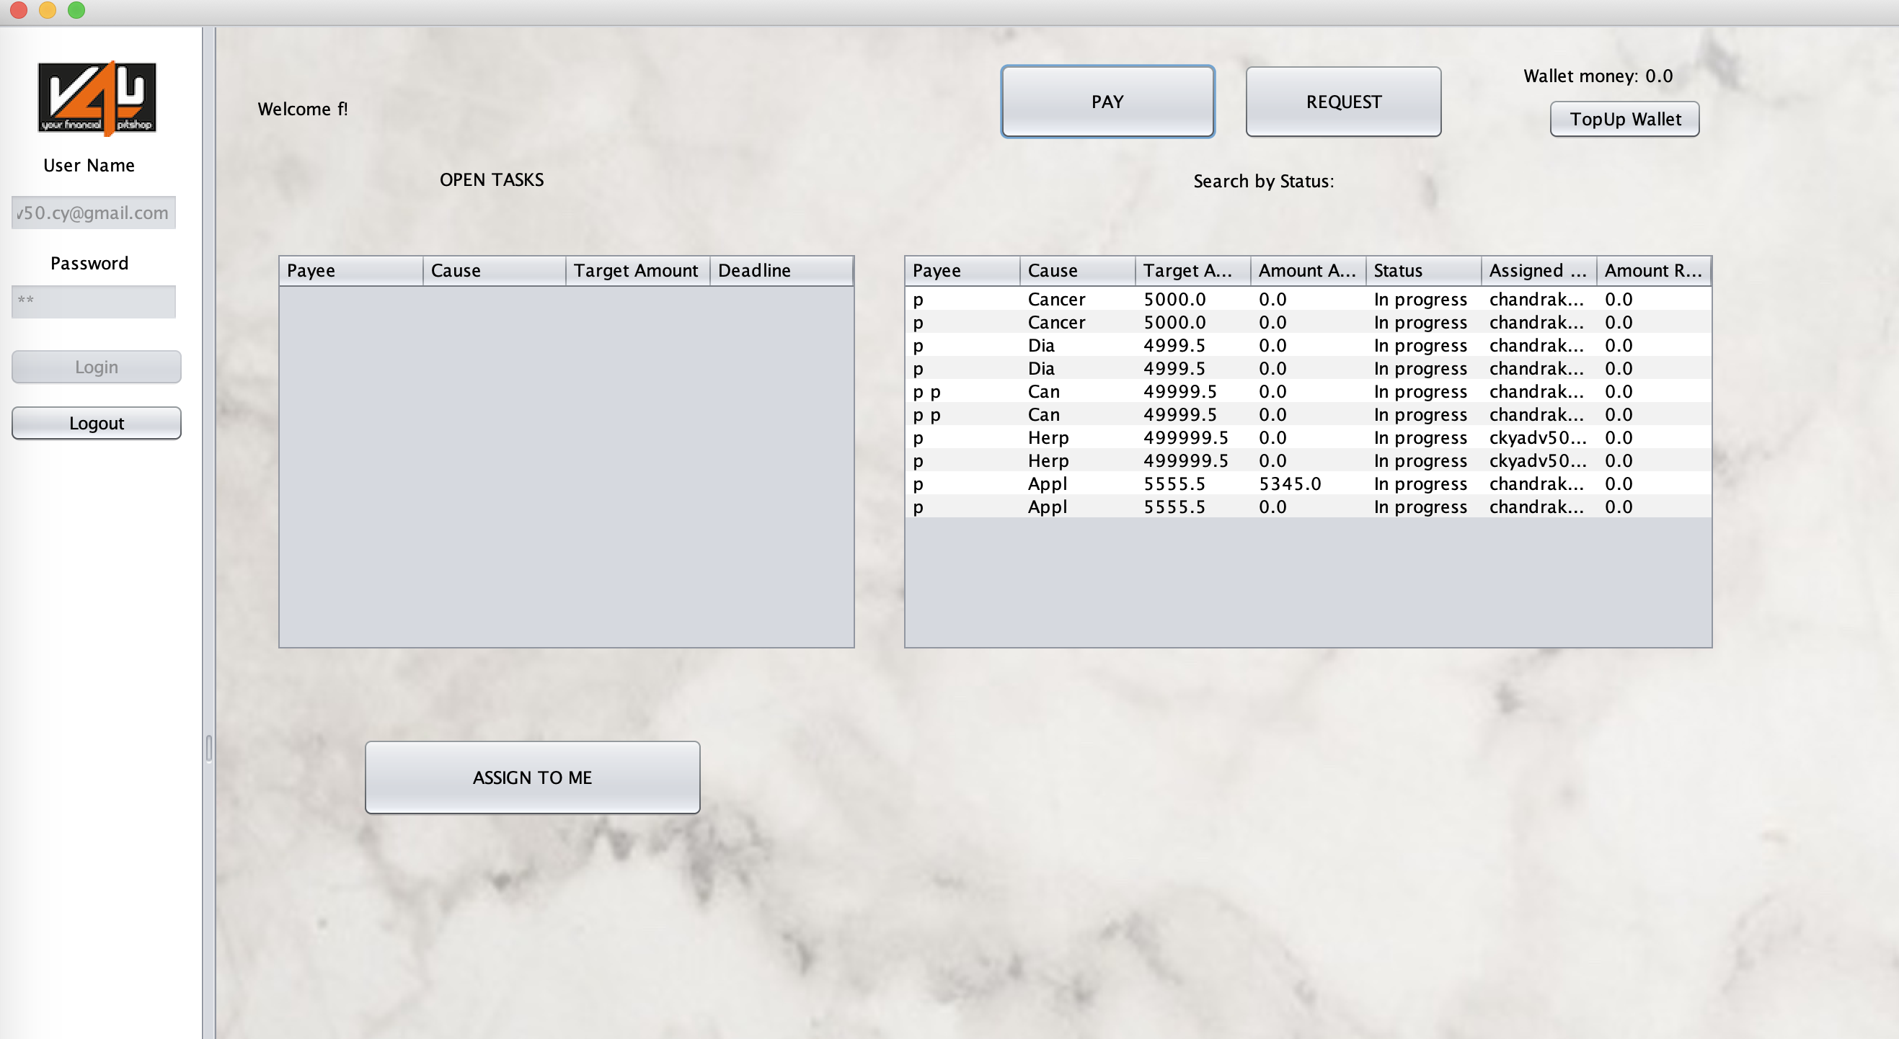

Slide 19
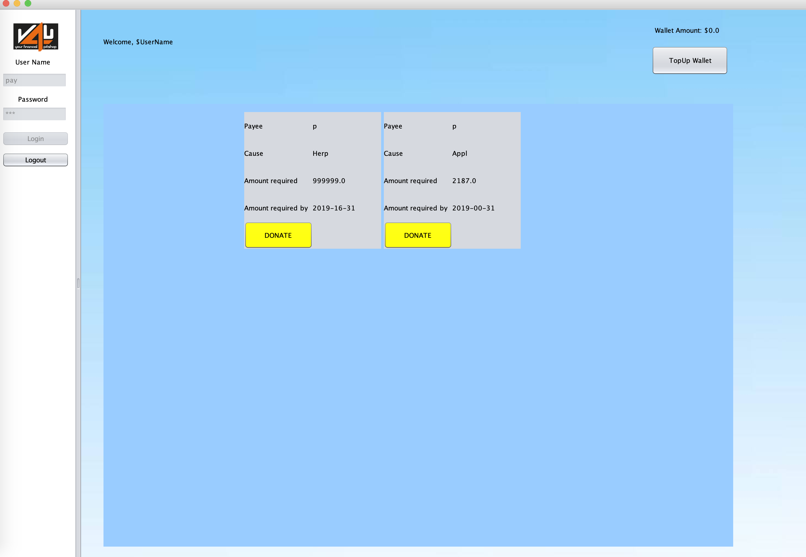

Slide 20
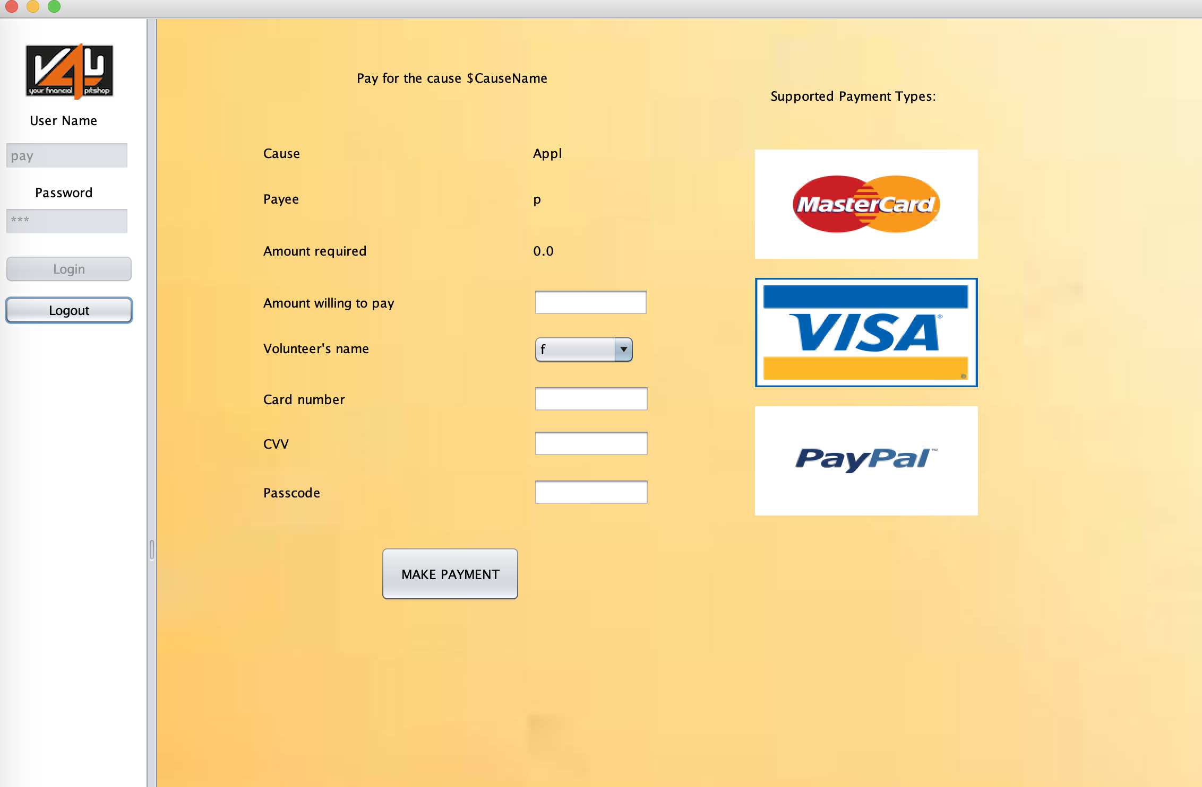

Slide 21

Thank you
Pavan Srikanta Rao (001393229)
Chandrakanth Chittappa (001300076)
Floyed Pinto
(001346150)

